Slide 1
National City Bank
CSCI E-96: Case Study #2
Group F: AJ Rivera, Michael Frick, Jim Lee, Vidur Nayyar

Slide 2

Introduction
Goals:
Your team has been asked to create a customer propensity model for a new product, specifically a line of credit against a household’s used car.
You are asked to identify the next 100 customers from a prospective customer list to contact
Steps:
Examine the historical data from 4000 previous calls and mailings for the line of credit offer
Using this historical data, and any supplemental data, create a propensity model, evaluate it and identify by uniqueID the top 100 households to contact from the prospective customer list
Notes:
Sample, Examine, Modify, Model, Assess

Slide 3
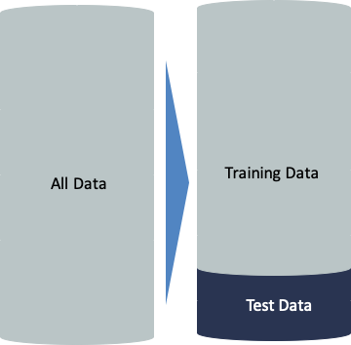
Introduction
Data Provided:
Data Dictionary
Prospective Customers
Previous Customer Marketing Results
Supplemental Information:
Household Axiom Data
Household Credit Data
Household Vehicle Data
Training Data: 80% of previous results
Testing Data: 20% of previous results
Predictive Modeling
Notes:
Prospective Customers (1,000)
Previous Customer Marketing Results (4,000)

Slide 4
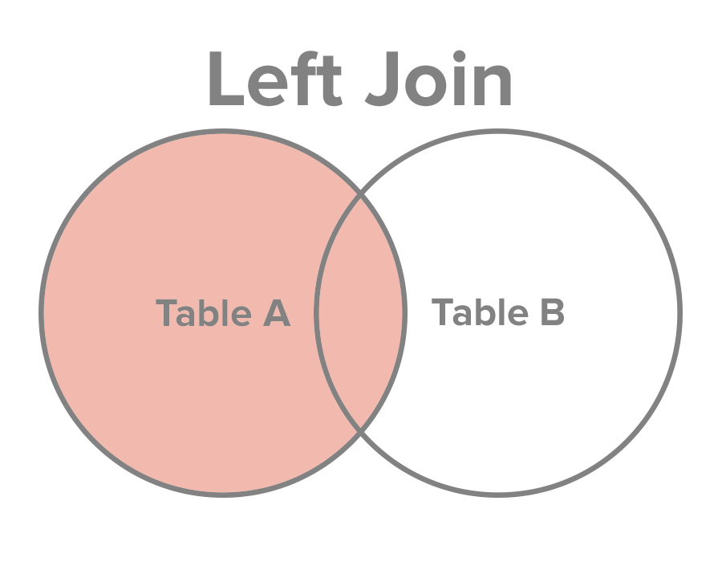
Exploratory Data Analysis (EDA)
29 overall variables, including dependent variable, when joining the supplemental with the training set
24 usable independent variables of the combined training and supplemental sets
"dataID" and "HHuniqueID" are NOT useful for prediction (internal IDs)
"CallStart" and "CallEnd" are NOT available in the Prospective Customer file
Notes:
Explain our data
Where we got our training data
How we distilled down our data frame
Why our variables are important, why we chose to exclude
Explain thought process behind our strategy

Slide 5
Modeling
Decision Tree - Jim Lee
K Nearest Neighbor (KNN) - Michael Frick
Random Forest - Vidur Nayyar
Logistic Regression - AJ Rivera

Slide 6
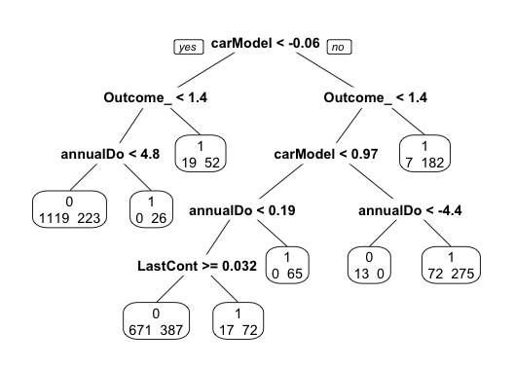
Model: Decision Tree
Pros: Tree based model that will split data into sections and create easy to follow rules for prediction
Cons: Prone to overfitting, should be carefully tested
Uses recursive partitioning to repeatedly split records to two sections (branches) around decision nodes
Pruning the tree (as shown on the left) to simply the tree is a possible solution to avoid overfitting

Slide 7
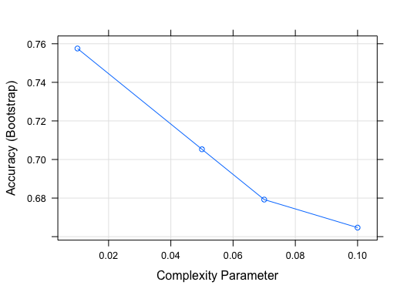
Model: Decision Tree
Using the R library Caret, generated a model with an optimal Complexity Parameter of 0.01
Removed variables:
Communication
DaysPassed
headOfhouseholdGender
PetsPurchases
AffluencePurchases
Result is an accuracy of 74.5% after running model on test set
Notes:
cp: control the size of the decision tree
The cp will measure the size of the tree compared to its ability to separate the data. The tree will grow until the next split doesn’t reduce the cp parameter

Slide 8
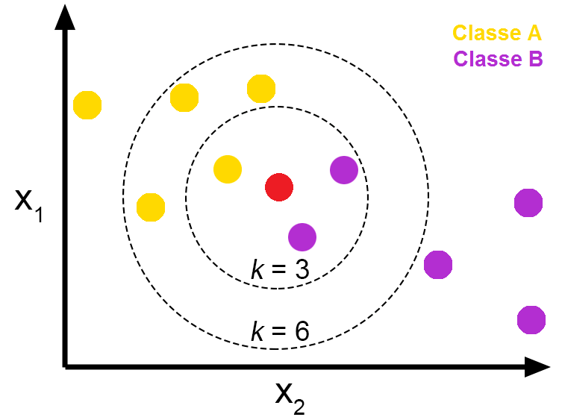
Model: K Nearest Neighbor
Stands for K-Nearest-Neighbor
Classifies a certain K-Value based on nearby records
Pros: Intuitive, simple to use model
Cons: Takes a long time to run
Uses Euclidean distance to measure the nearest neighbors
Example on the right shows a k=3 would indicate the red is Classe B, while k=6 the red is Classe A

Slide 9
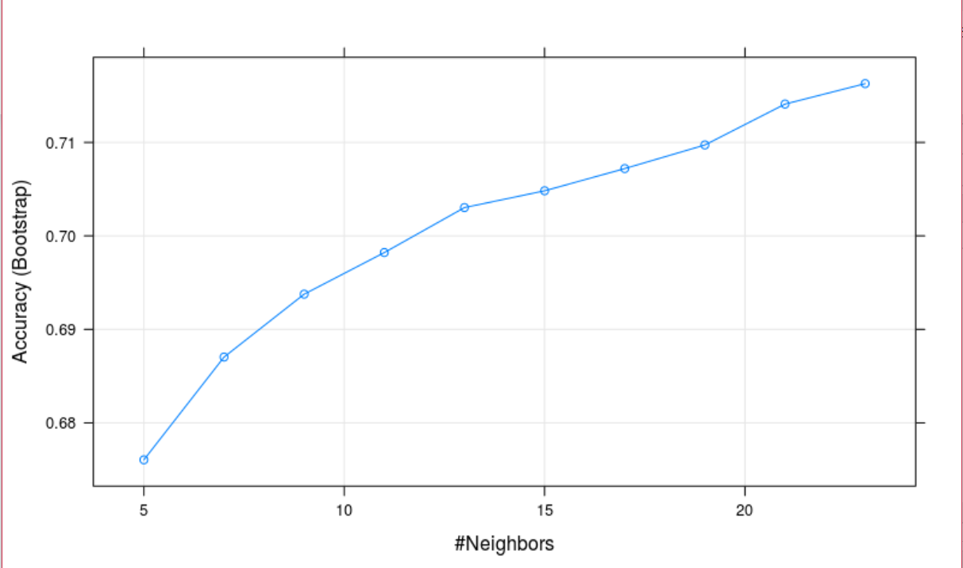
Model: K Nearest Neighbor
Fitted the KNN model with Y_Accepted_Offer as being the dependant variable, and all other 24 variables as independent
KNN allows for a large number of variables and classifies the dependant variable relative to those variables
Accuracy: 72.88% after running model on test set

Slide 10
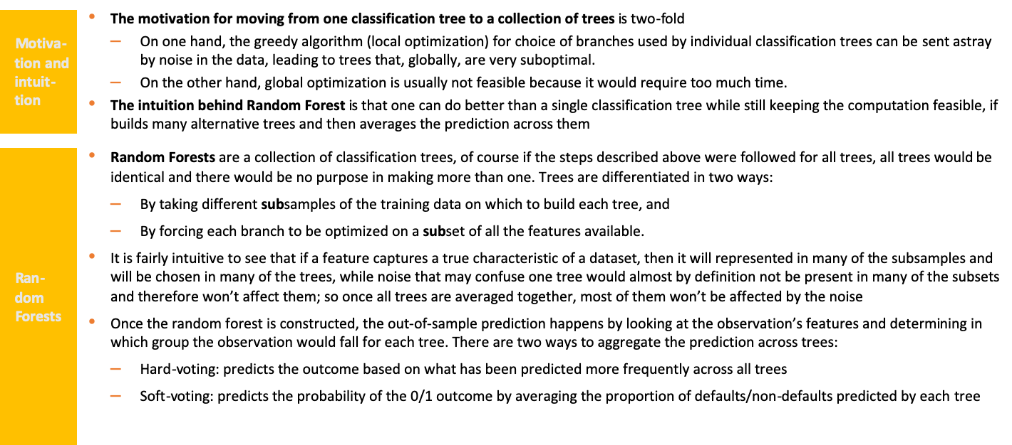
Model: Random Forests

Slide 11
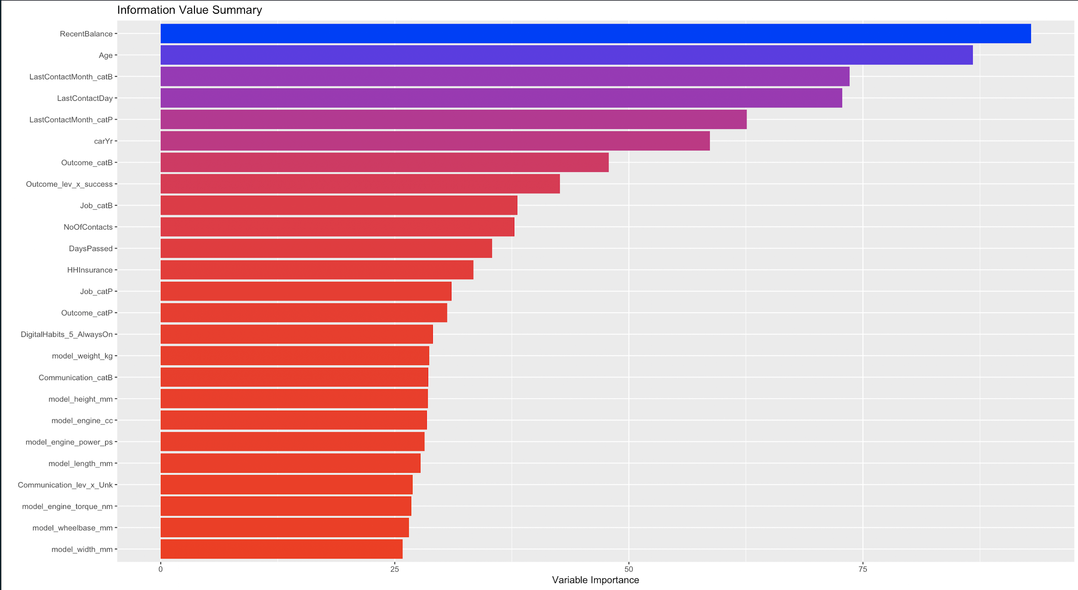
Model: Random Forest
Customers details like recent balance, age and last contact date are most predictive in determining the propensity of the customer to buy a new product
Additional variables mined from the web about the cars slightly improve the gini score of the model
Accuracy of 74.1%
External data: https://www.carqueryapi.com/

Slide 12
Model: Logistic Regression
Is a popular and powerful classification method but also can be used for prediction in the sense that we predict the probability of a categorical outcome.
Relies on a specific model relating the predictors with the outcome - must specify the predictors to include as well as their form
Applicable in situations where the outcome variable “Y_AcceptedOffer” is categorical and focuses on binary classification “Yes=1” or “No=0”
Can be used to classify new records where its class is unknown, into one of the classes based on the values of its predictor variables
Cons: Susceptible to multicollinearity and may need to be analyzed to remove
Notes:
-Multicollinearity: is assessed by computing a score called the variance inflation factor (or VIF), which measures how much the variance of a regression coefficient. So, the smallest possible value of variance inflation factor is one without multicollinearity

Slide 13
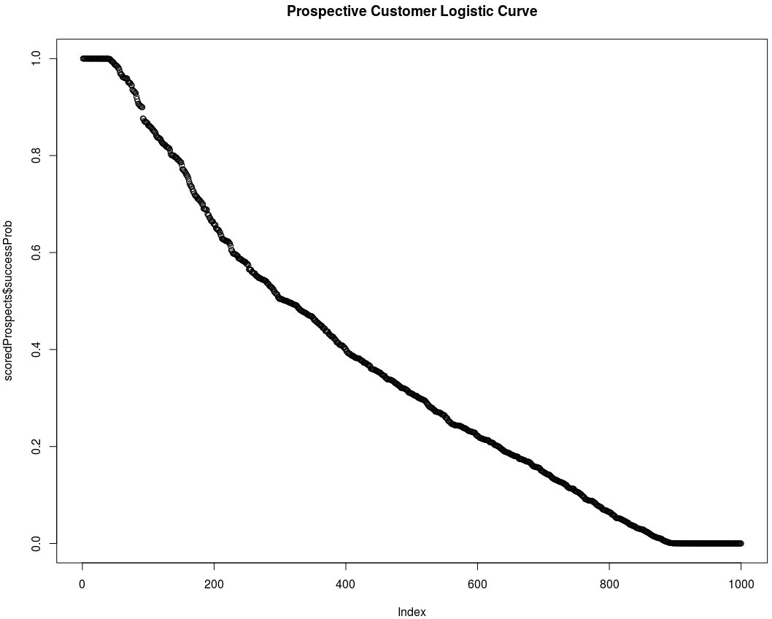
Model: Logistic Regression
Goal: to predict which class “Y_AcceptedOffer” will belong to, or simply to classify the record into one of the classes, “Yes” or “No”
Used a cutoff of 0.75 for best results
Used Caret on a 10 fold cross validation to get better accuracy
Result is an accuracy of 79.75% after running model on test set
Notes:
-Cutoff: increased threshold from a standard 0.5 to 0.75. we’re making a balance between the false positive rate (FPR) and false negative rate (FNR). we’re trying to minimize the number of mistakes we’re making
-Caret 10-fold cross validation is a technique involves randomly dividing the dataset into groups or folds of approximately equal size for better accuracy

Slide 14
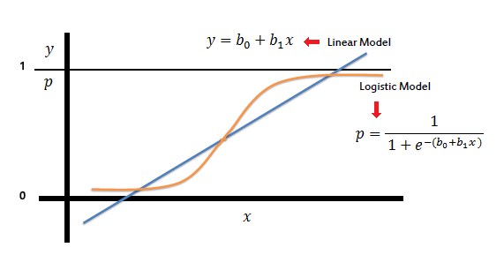
Model We Chose: Logistic Regression
Highest accuracy of all of our models
Difference between linear regression and logistic regression highlighted on the right
This model gives us a more precise indication as to who the bank should contact
Notes:
-Linear Regression: is a very widely used statistical tool to establish a relationship model between two variables.
-GLM: measures the relationship between the categorical dependent variable and one or more independent variables by estimating probabilities

Slide 15
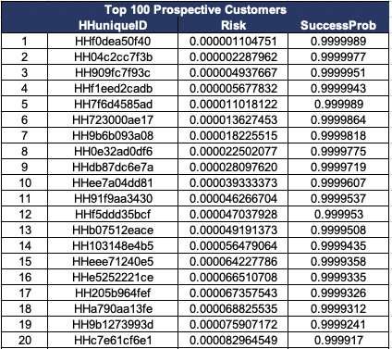
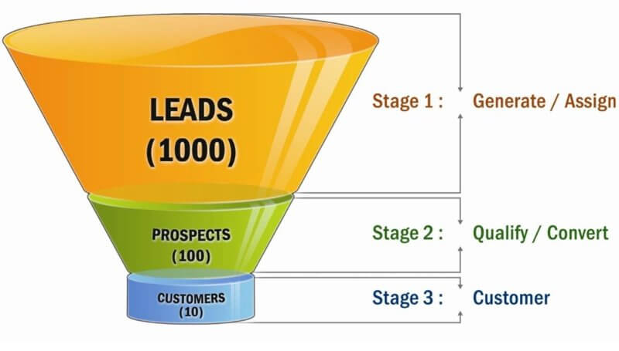
Results: Top 100 Prospective Customers
Results above show 20 of the top 100 prospective customers we identified

Slide 16


